Slide 1
Using RDKIT in an ML-Workflow to Identify Small Molecule Binding Sites Across the Human (or any) Proteome
Byron DeLaBarre
“The Consulting Biochemist”
RDKIT UGM 10 April 2025
byron.delabarre@consultingbiochemist.com

Slide 2









My Team

Slide 3
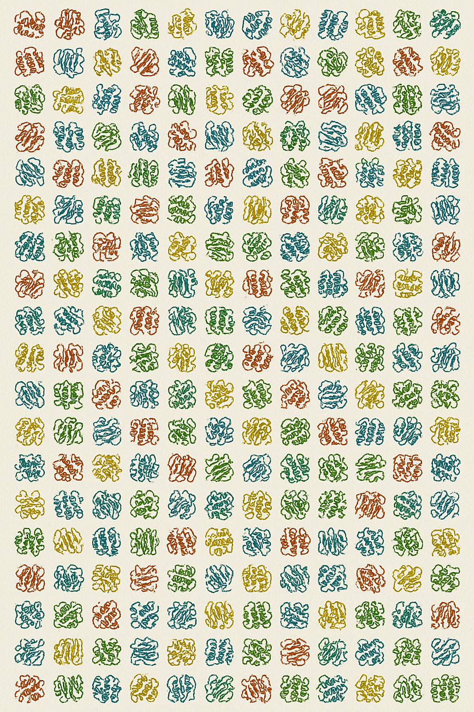


Realizing Potential in the Potentially Useful

Slide 4

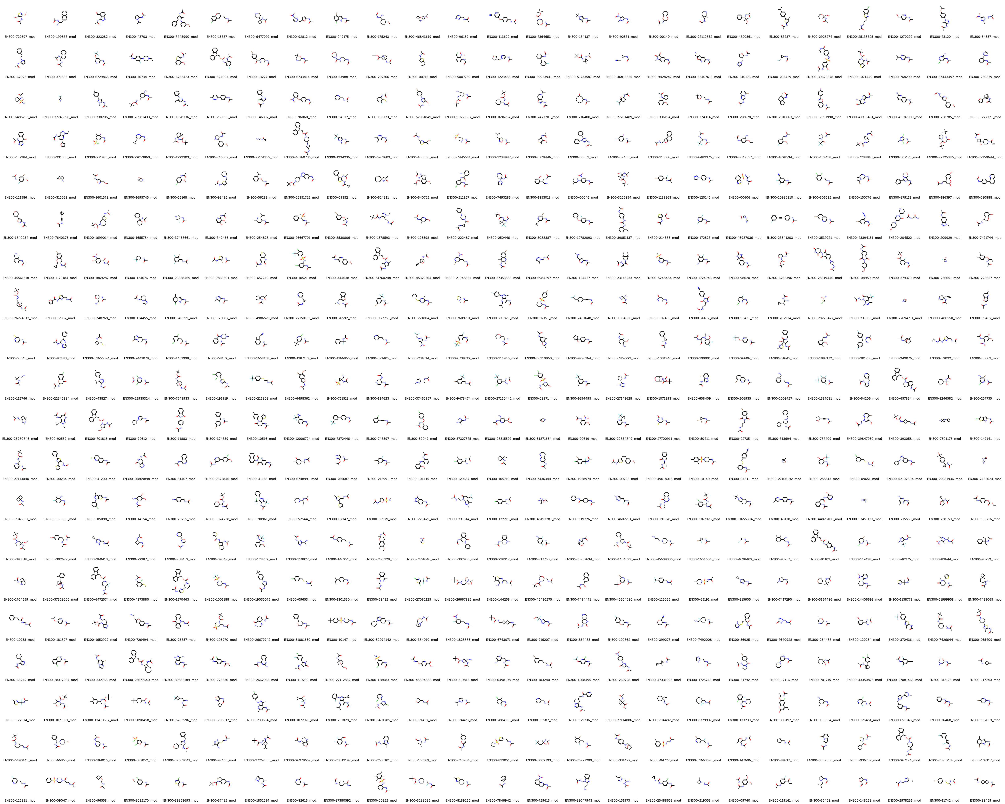

Structures are the Starting Point – Interactions Are the Goal
ML-PEPPER LIGAND FINDING
PH4 BASED BOT

Slide 5

“ML-PEPPER”
Alphafold Structure Database
(or any collection of pdb coordinates)
Goal: Create a tool that can generate a representative set of pharmacophores to enable the design of focused chemical libraries
Pocket Identification by Veronoi Tessellation
Machine Learning Based
Proteomic Structure
Enabled
Pocket
Pharmacophores for
Enhanced
Recruitment
ML-PEPPER LIGAND FINDING
Protein based pharmacophores
PH4 BASED BOT
Clustering
Search vendor(s) database with representative pharmacophores
Cluster / filter to screenable library
Filter for pocket orientation/fit
Off-target / Tox Potential / Cross-organism comparison / Metabolism / Other methods?

Slide 6
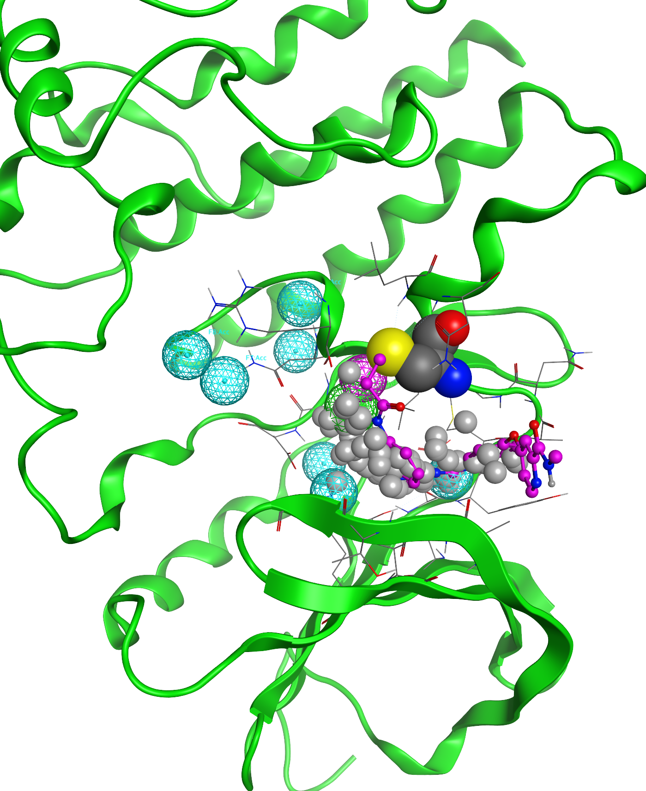
Proteins, Pockets, PH4s
PH4s are an abstraction of the ligand binding requirements that can be represented as a collection of 4D vectors (type + x/y/z)
These can be based on bound ligands or the residues comprising the pocket. We are using the protein based PH4s here
On average each protein will have 3-5 good pockets capable of binding a ligand
Big basket of low hanging fruit: we are restricting ourselves to static, monomeric pockets as defined by the AlphaFold2 database
Pockets can change:
Conformational dynamics
Multimer / complex formation
55M disclaimer: we are ignoring solvation/desolvation issues for now
BTK (green) bound with covalent inhibitor (magenta) to Cys (CPK spheres)
Gray spheres are alpha spheres refined from Voronoi tessellation based pocket prediction
Blue/magenta/green are receptor based pharmacaphores (PH4s) (acceptors/donors/hydrophobic)

Slide 7
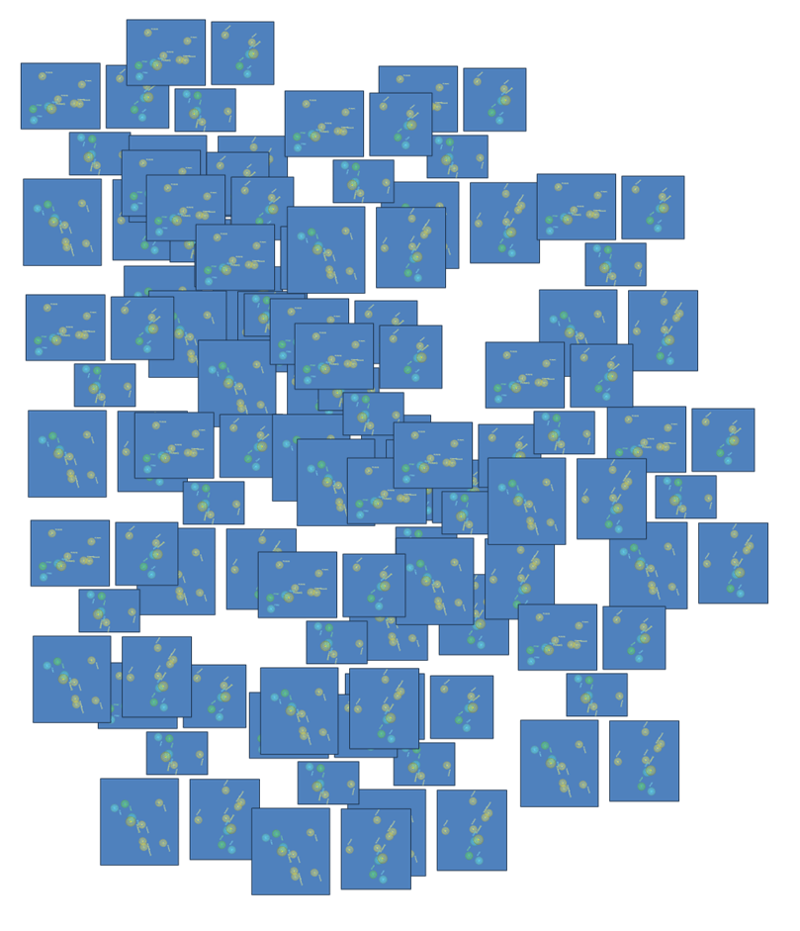
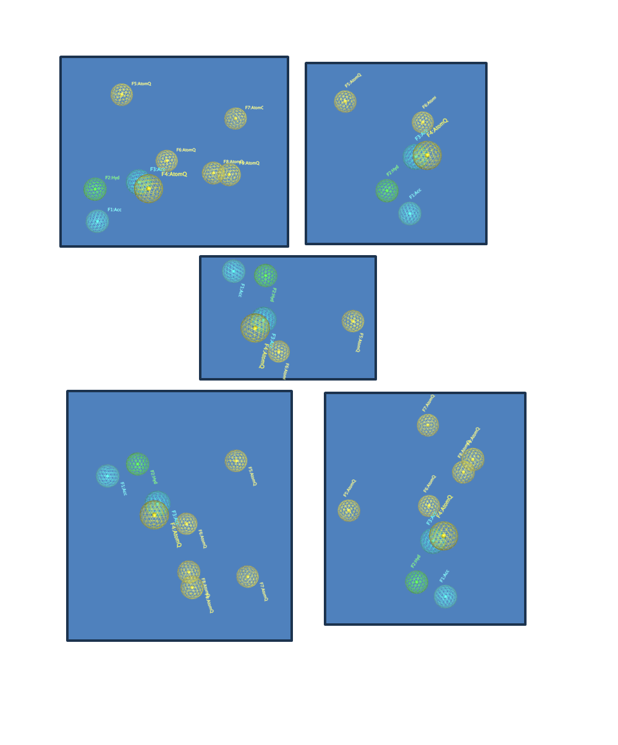
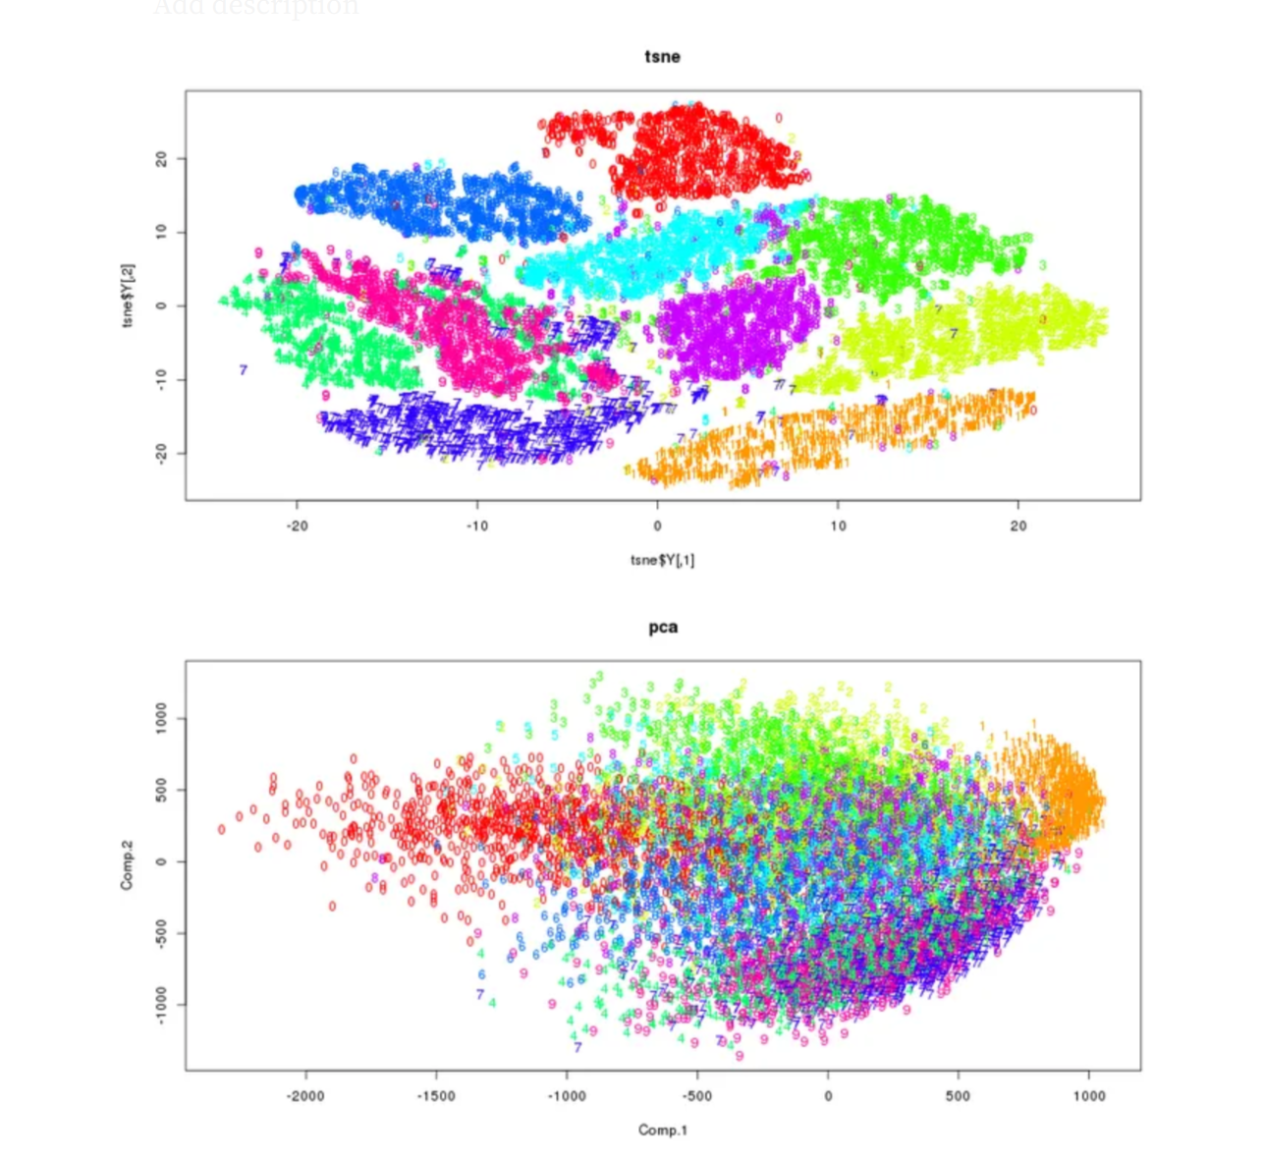
Clustering with t-SNE: Reducing Complexity
“t-Distributed Stochastic Neighbor Embedding”
tSNE
(showing example of handwritten digits 0-9)
“Pocket-ome” PH4 Collection
Representative “Pocket-omes”

Slide 8
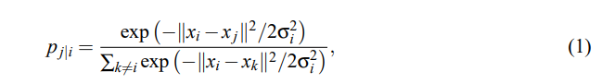
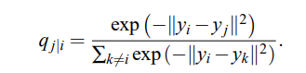
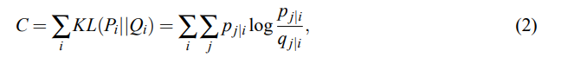
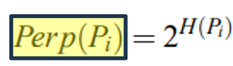
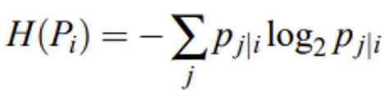
t-SNE Clustering is Highly Dependent on “Perplexity”
t-SNE reference: Maaten & Hinton, J Mach Learning Research, 2008
Neighbors are selected by conditional probabilities under a t-distributed Gaussian (Eqn 1)
Similarity of map point 1 to map point 2 modeled by Eqn 1B
The Kullback-Leibler (KL) divergences are minimized by gradient descent with cost function shown in (Eqn 2)
Perplexity setting affects the change in variance (σ_{i}) across the dataset (Eqn 3)
It is a smooth measure of the effective number of neighbors and is related to the amount of outlier information present in the dataset
Neighbor selection
Similarity Score
(1B)
Cost function
What is a Neighbor?
Where H(P_{i}) is the Shannon entropy of P_{i} measured in bits
(3)

Slide 9
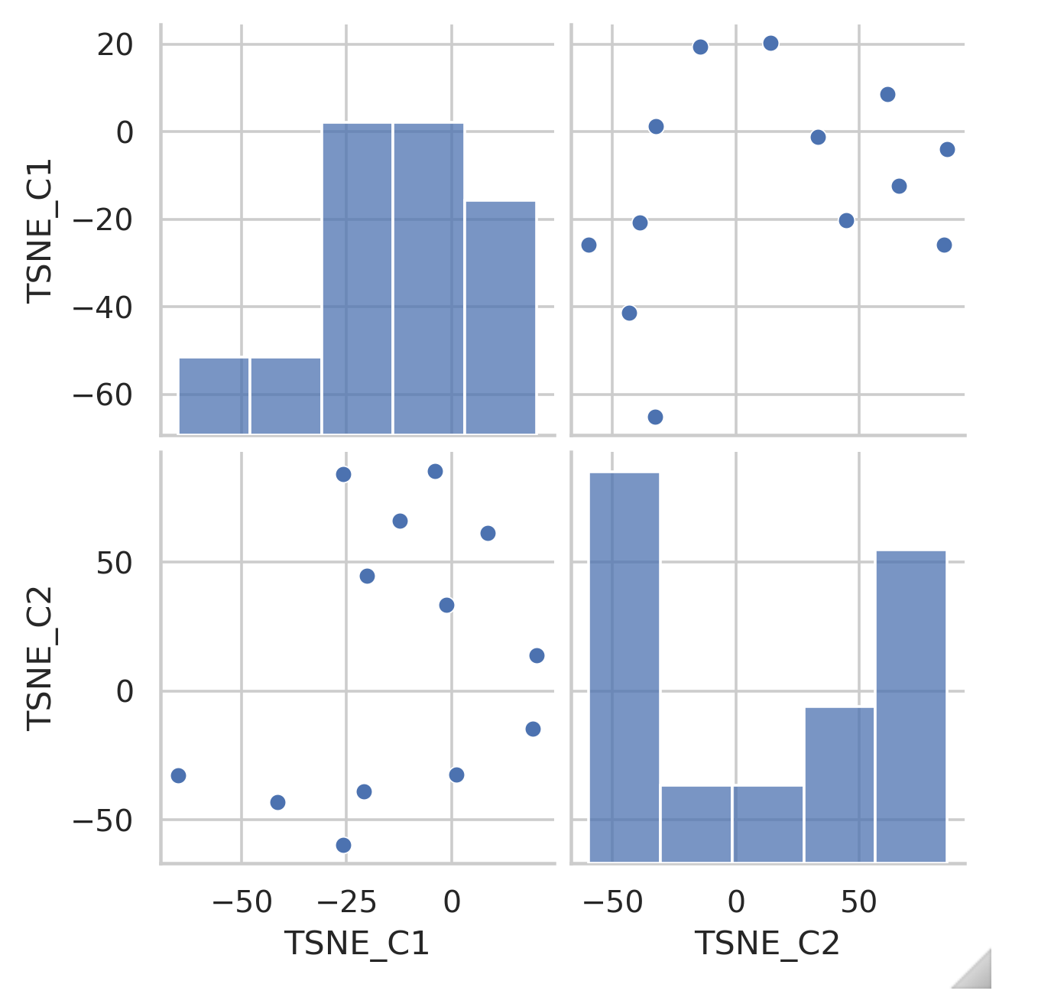
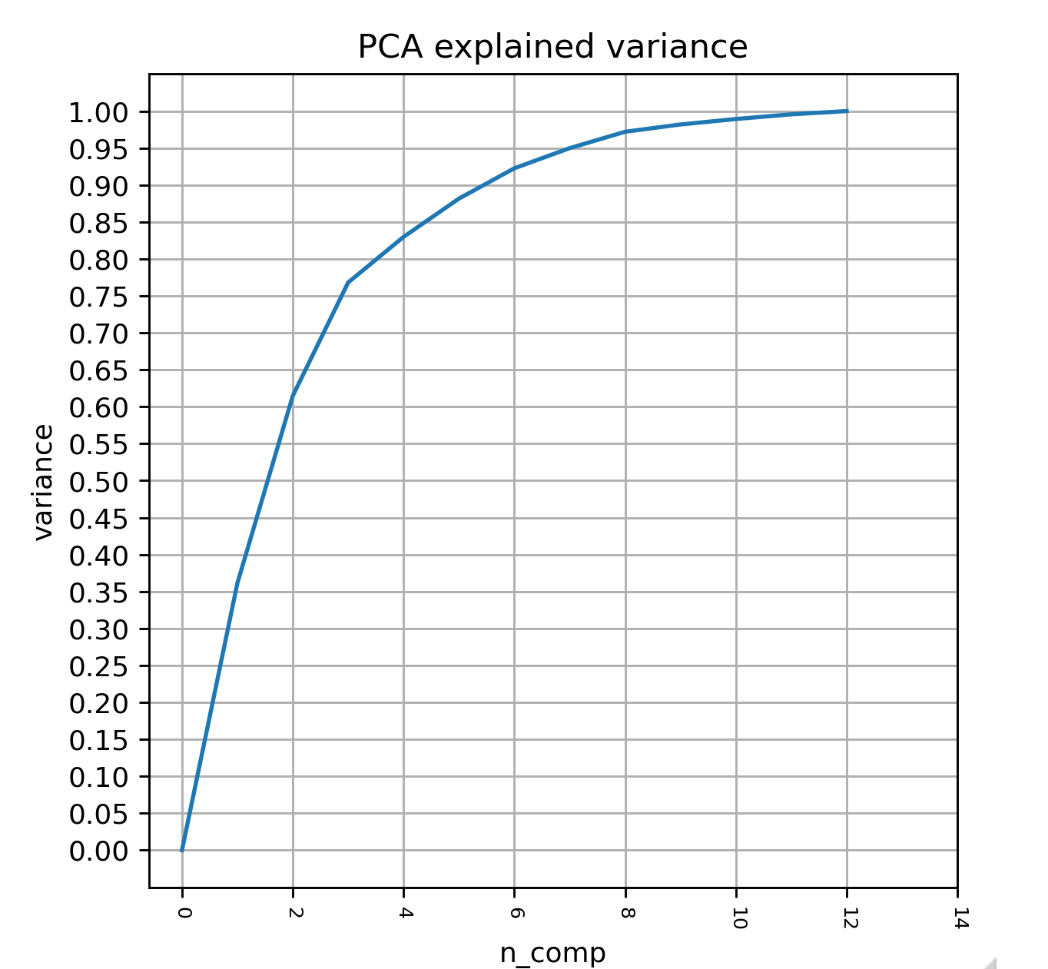
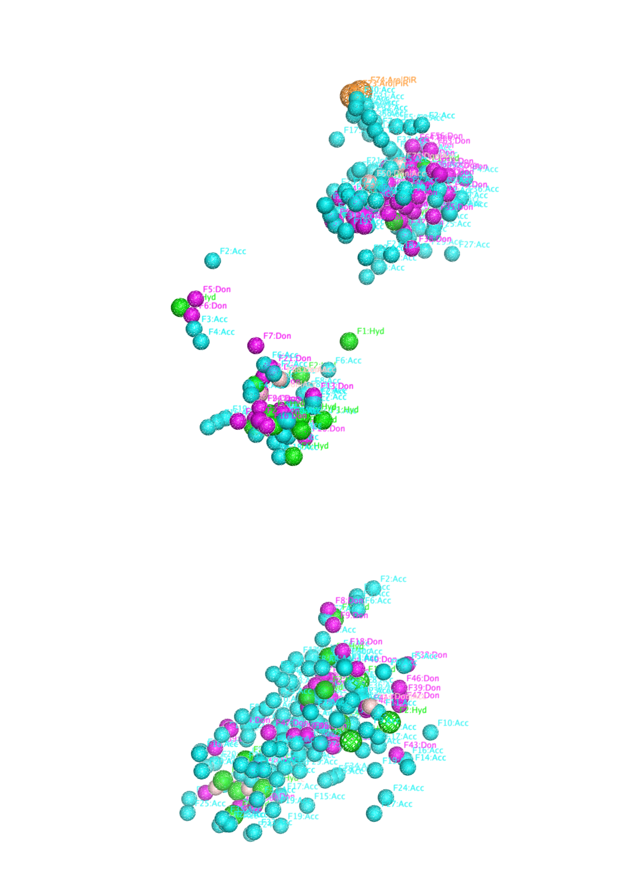
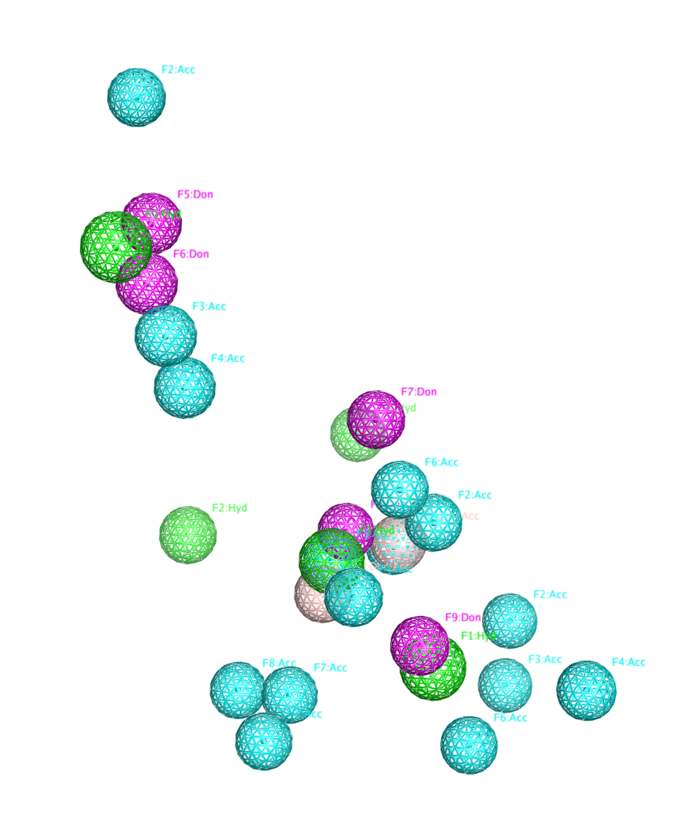
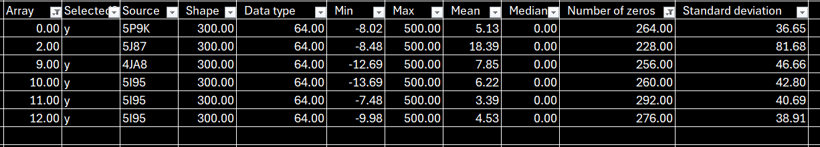
Baby Steps: Clustering a Small Curated List of Proteins
Cluster arises from:
5P9K (BTK)
8VHC (IDH1)
4JA8 (IDH2)
5I95 * 3 (IDH2)
Clustered 12 pockets derived from 7 proteins
3 BTK covalent complexes
1 EGFR complex
1 IDH1
2 IDH2

Slide 10
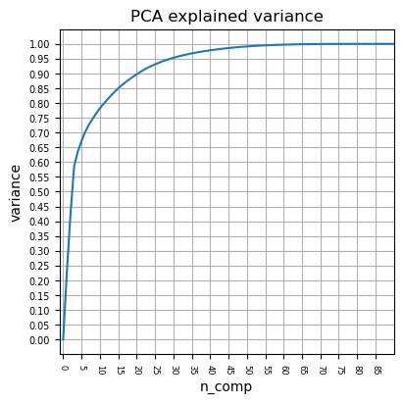
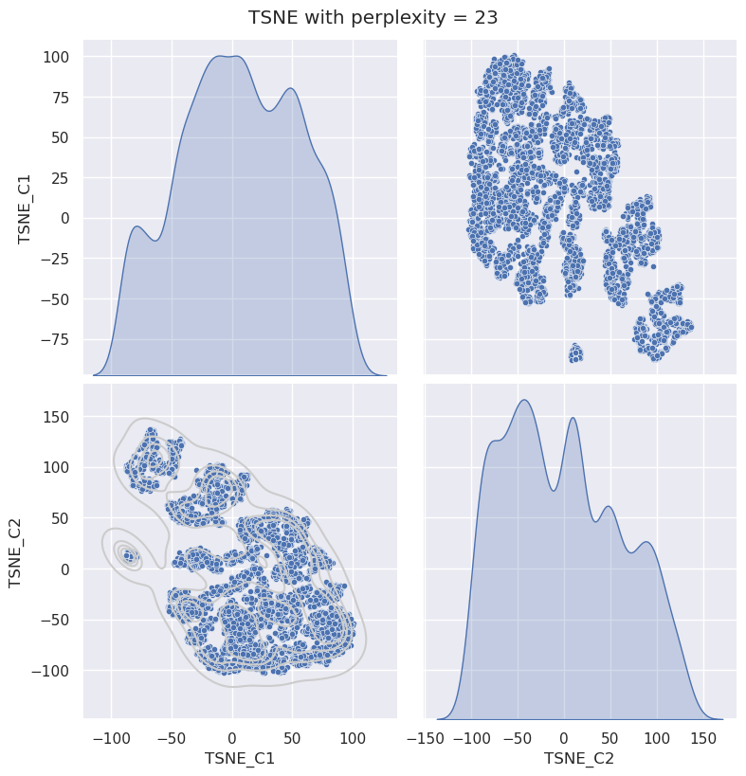
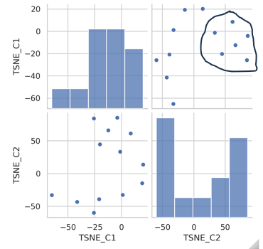
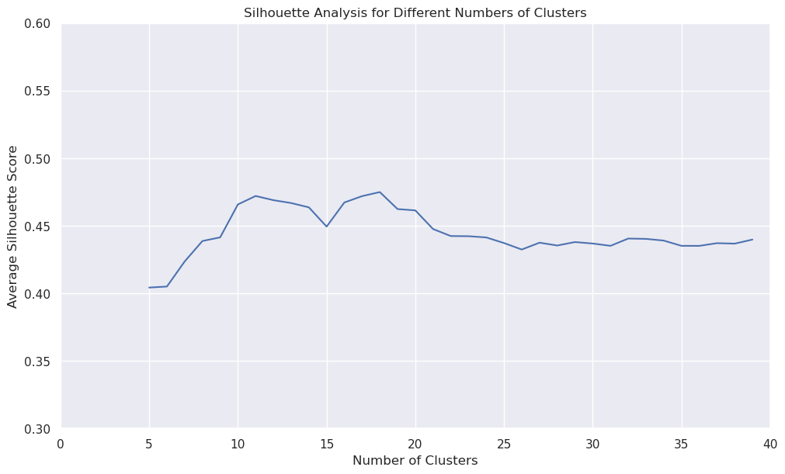
Objective Grouping is Critical: A “Trust But Verify” Analysis
Stage I
Perplexity
Sample around PCA cut off
Silhouette analysis is looped with iterative t-SNE perplexity to quickly find the best perplexity/group size setting
Silhouette analysis:
Consider a range of potential groups
Scores all elements from -1 to 1 on their inclusion in a particular cluster
Averaged score of all elements provides an objective clustering score
Silhouette grouping 5-40
Stage II
Perplexity
Fine sample
Silhouette Score
Silhouette grouping 5-40
Stage III
Select optimal perplexity and group setting
# Clusters

Slide 11
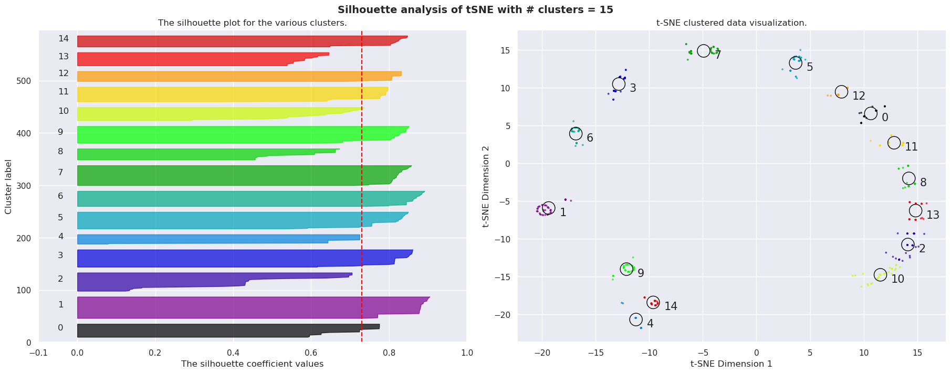
Detailed View of Silhouette Analysis With Automated Grouping
Group separation enhanced via ‘late exaggeration’

Slide 12
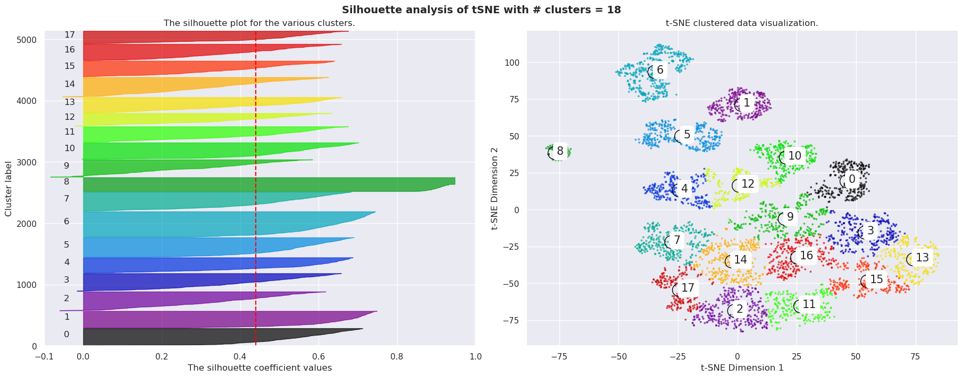
Clustering of 10% of the Human Proteome Represented as PH4s

Slide 13
So far…..
A random draw constituting 10% of the AF2 database was used to generate a library of pockets and their associated pharmacophores
These were then clustered into a representative set of PH4s that are an ~250x reduction in complexity from the original protein coordinates
All very nice…but how do we confirm that we are doing something aligned with reality

Slide 14

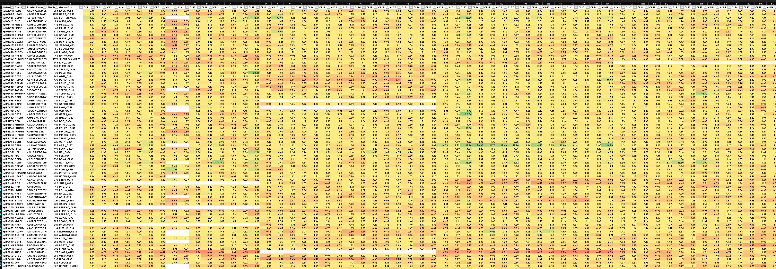
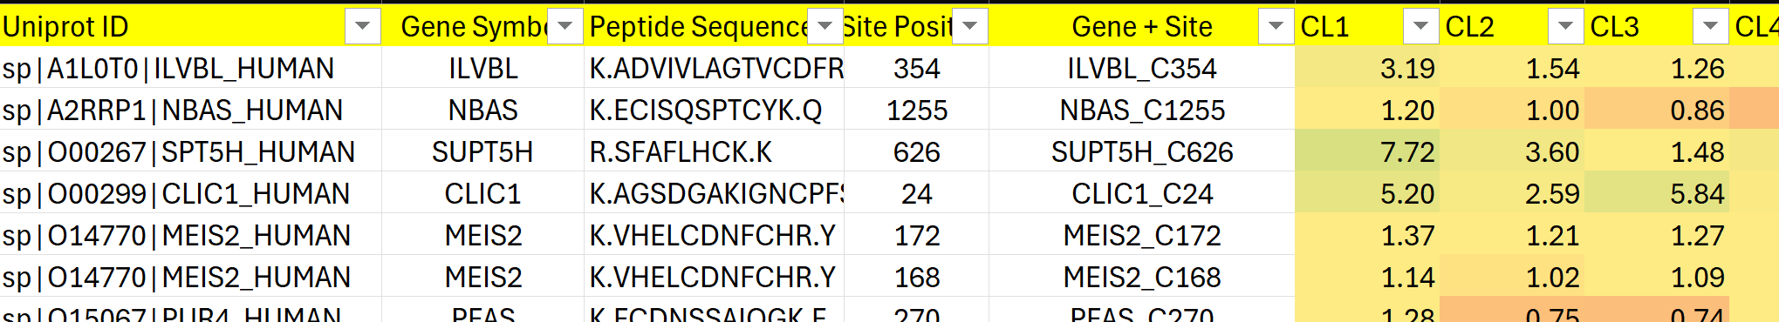
Gygi Electrophile Dataset
Competition Ratio Response to 285 compounds (chloroacetamides / acrylamides)
HEK
PaTu
(685)
(889)
346
352
387
20K entries on modified Cys residues in HEK lysate
242
315
343
354
(1400)
HCT
Gygi’s group screened the full set of proteins detectable from 3 different human cell lines using a small covalent library
This work was a technical tour de force that represent a >40x jump in screening throughput
More importantly – they published all of their experimental results in a relatively easy access format.
(Nat Biotechnol. 2021 May ; 39(5): 630–641. doi:10.1038/s41587-020-00778-3)

Slide 15
Validating ML-PEPPER with the Gygi Electophile Dataset
PaTu
HEK
ML-PEPPER Analysis: Pockets, PH4s
(685)
(889)
Filtering yielded ~2400 proteins across all 3 cell lines
8391 pockets near Cys residues
6495 of those have Cys facing into pocket or otherwise not obscured by other structural elements
4959 have detectable PH4 elements (acceptor/donor/pi)
4959 PH4 reduced down to 17 clusters
346
352
387
242
315
343
354
(1400)
HCT
Filtering
Filtered Gygi data for rows that have missing data count < 30 (i.e. ~90% complete) and response range >2.5
Sufficient overlap to allow for prediction validation (was there a prediction for the pocket in question)

Slide 16
Using PH4 to Scan a Set of Chemicals
Gygi data from Enamine catalog libraries
RDKIT made visual inspection of the library and modifications easy (removed Cl to better represent reacted state)
Compounds were conformationally enumerated with MOE (haven’t tried RDKITs approach yet!) to ~5K entries
10% of clustered PH4s were used to search the 5K conformational library (~2500 dockings)
One more step required: is the warhead near the cysteine?

Slide 17
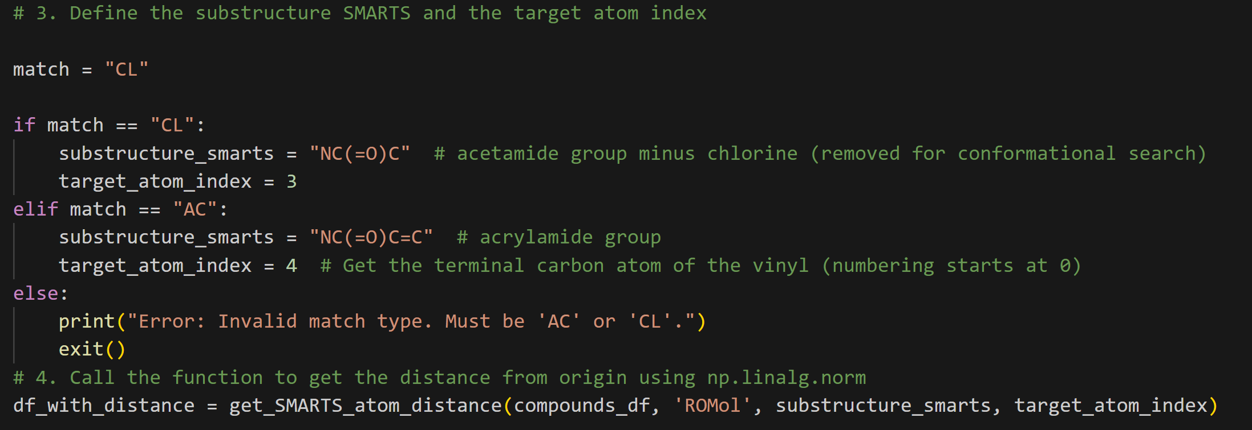
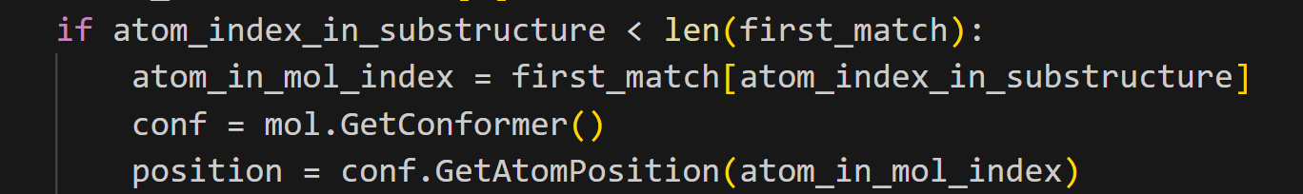
RDKIT (and AI) Made This Step Easy!
Coding was provided nearly verbatim by coding AI:
Me to AI: “Use RDKIT to locate an atom in the acrylamide near Cys atoms”
(sometimes)

Slide 18
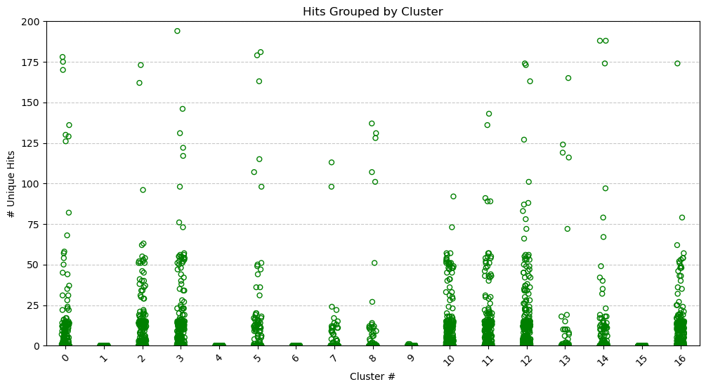
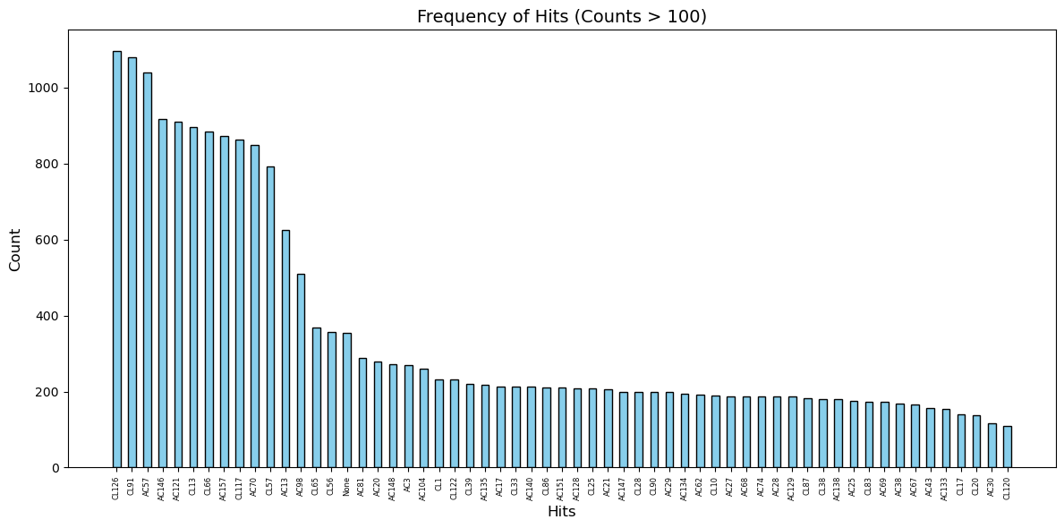
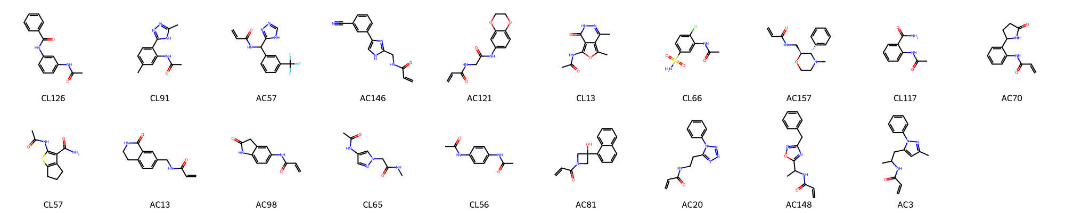
The #of hits varied by cluster
Some clusters provided no hits. Generally these had lower (<4) PH4 features
Before looking at the composition of the hits in each cluster it is useful to look across all clusters for promiscuous compounds

Slide 19
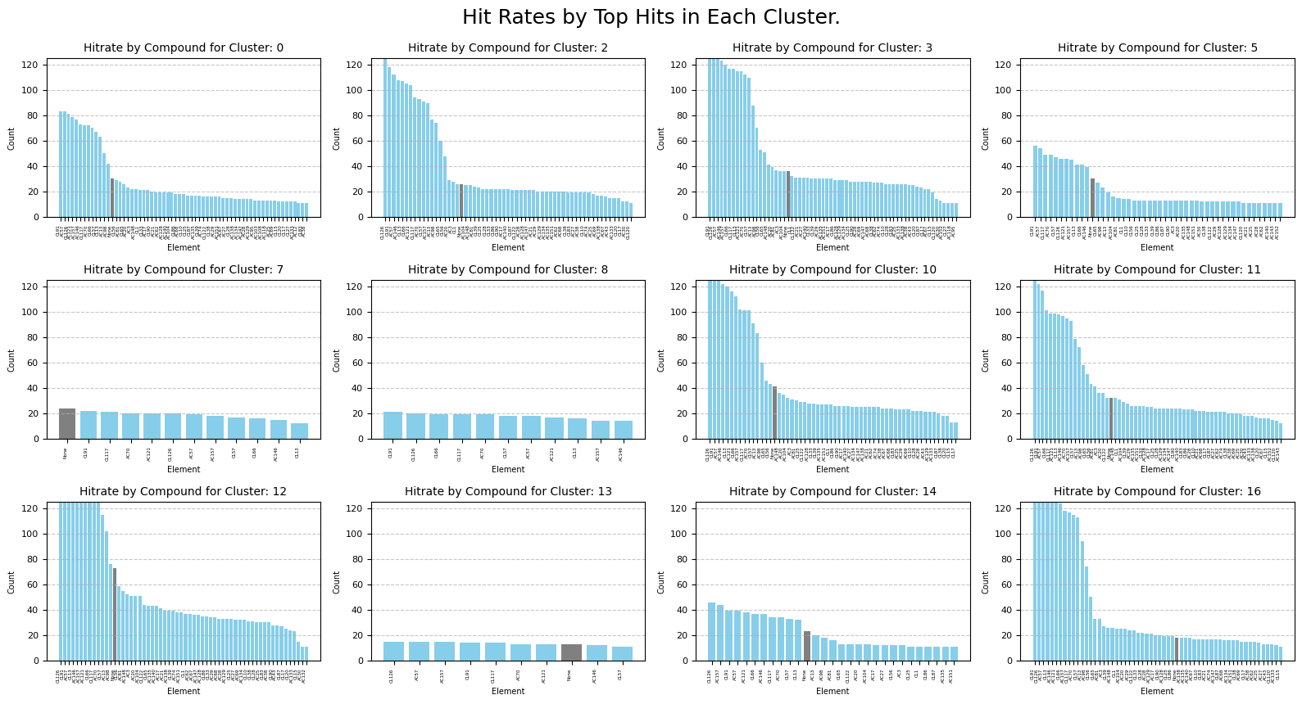

Slide 20
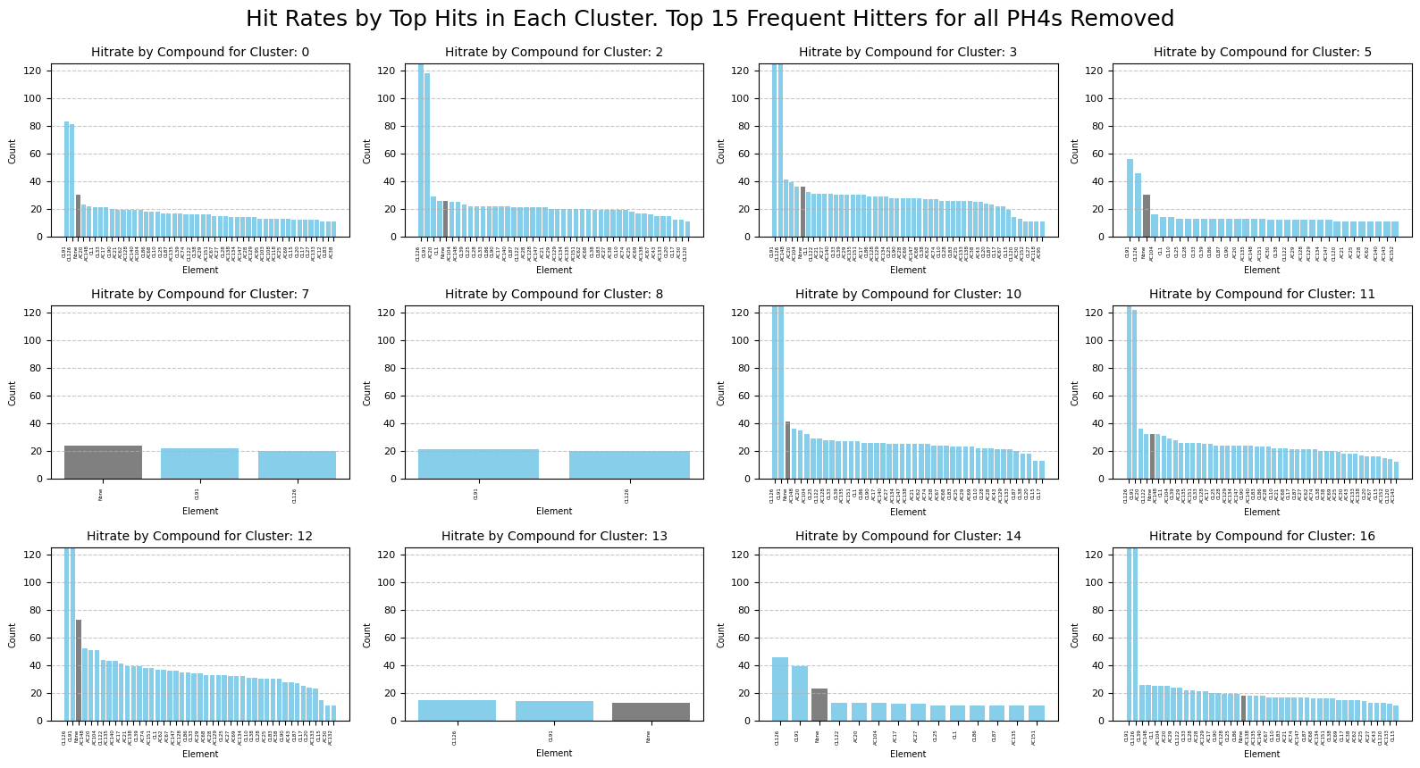
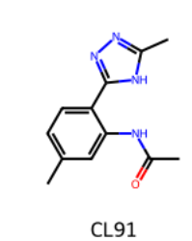
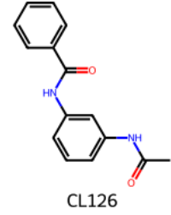

Slide 21
Comparing the ML-PEPPER Predictions to the Gygi Dataset
Showing just the HEK Data here…other cell lines are in progress

Slide 22
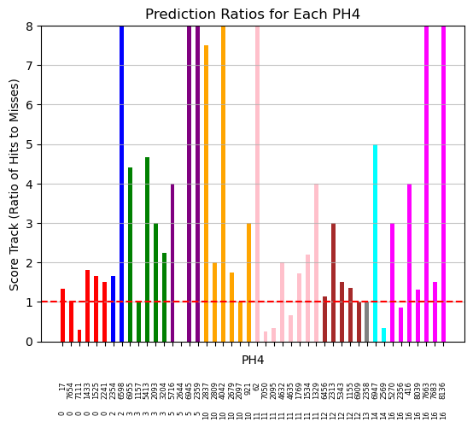
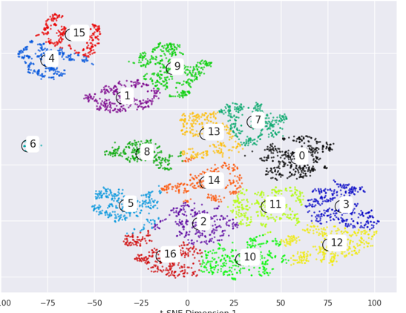
X
X
Prediction ratio:
Number of True positives
Number of False positives

Slide 23
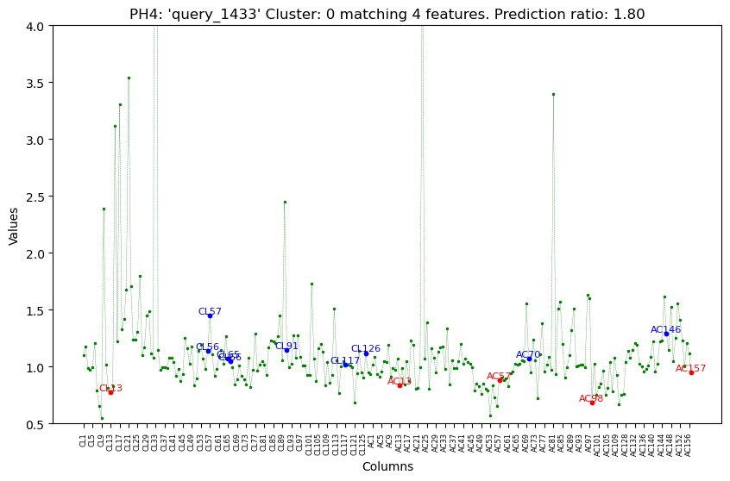
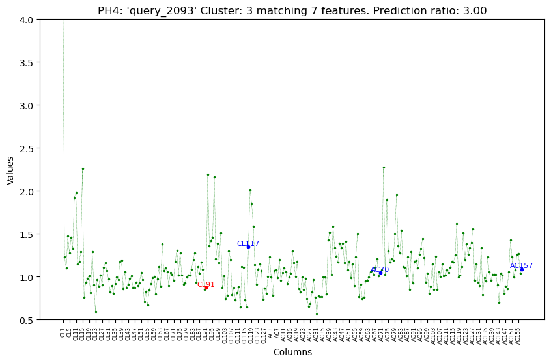
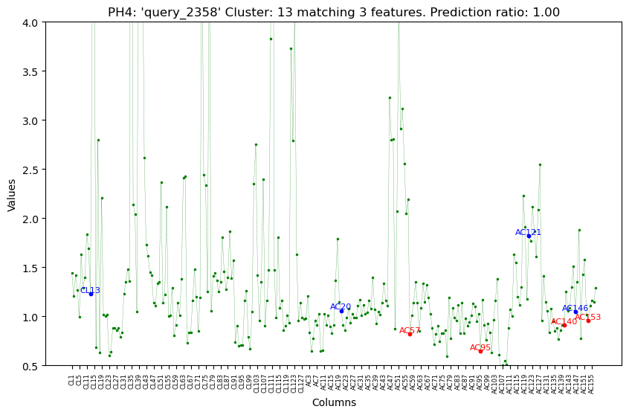
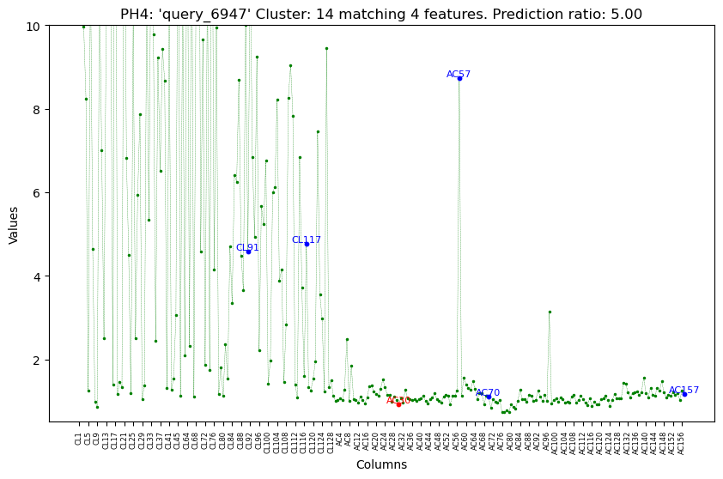
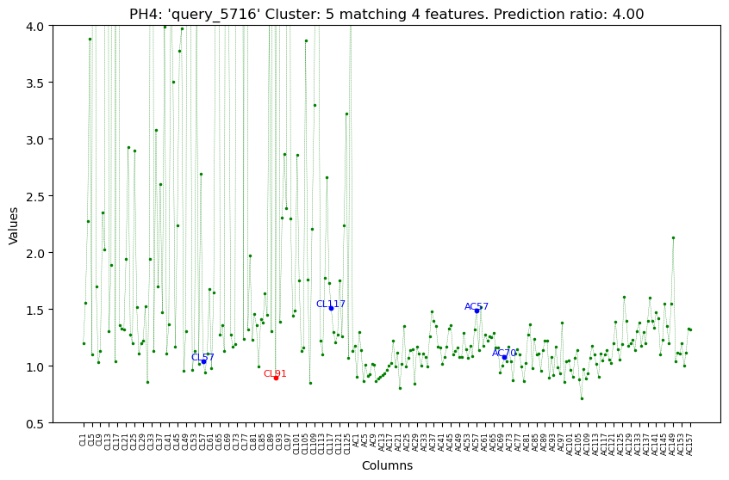
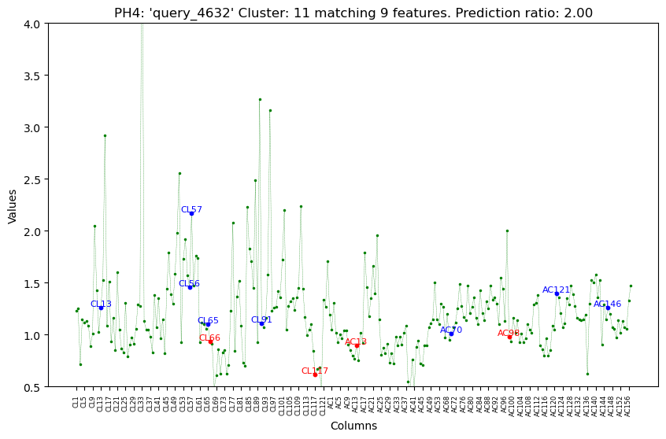
Cluster 0
Cluster 3
Cluster 13
Cluster 14
Cluster 5
Cluster 11

Slide 24
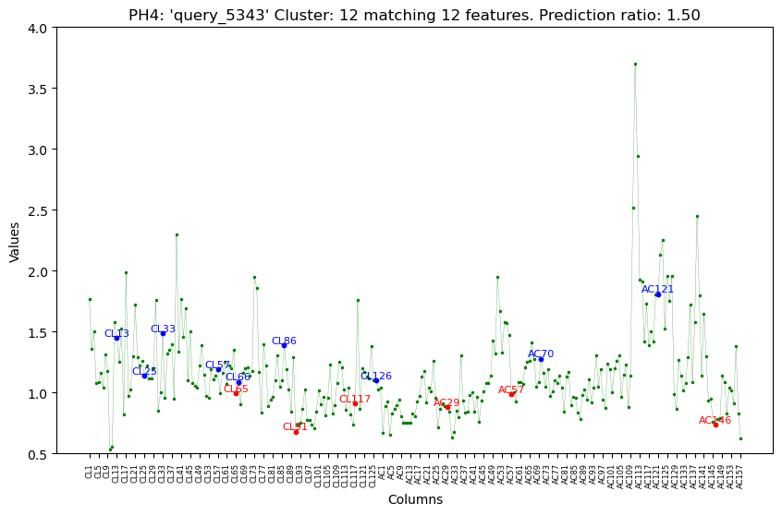
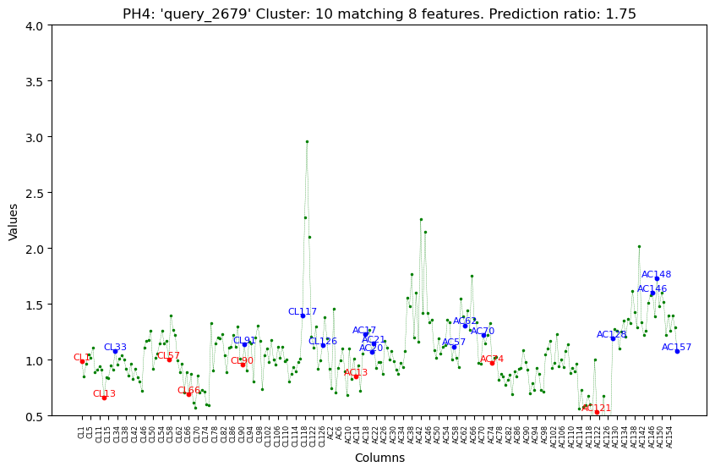
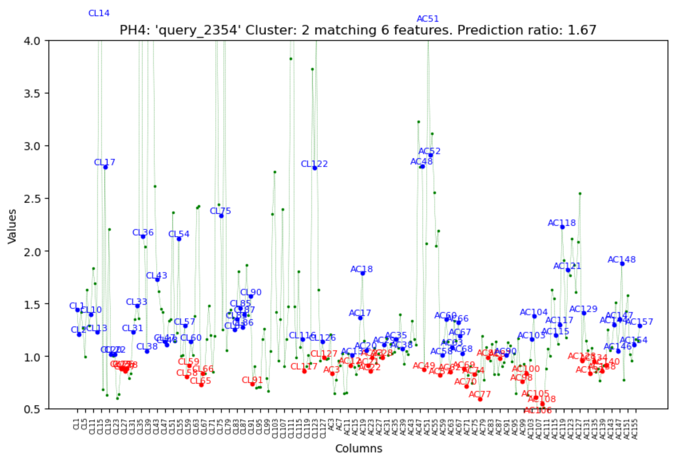
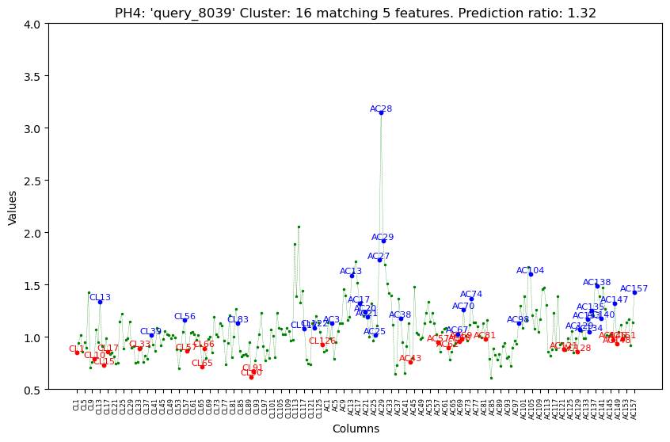
Cluster 12
Cluster 10
Cluster 2
Cluster 16

Slide 25
Conclusions
ML-PEPPER is a useful tool for understanding small molecule binding by a large protein collection
A machine learning loop comprised of t-SNE with silhouette analysis provided an unsupervised clustering of pharmacophores
RDKIT (along with others) was a critical ally in the creation of this workflow. THANK-YOU!
Potential Applications include:
screening/DEL library composition
potential off-target/tox analysis
fuel for small molecule AI-diffusion methods?
byron.delabarre@consultingbiochemist.com

Slide 26
Backup

Slide 27
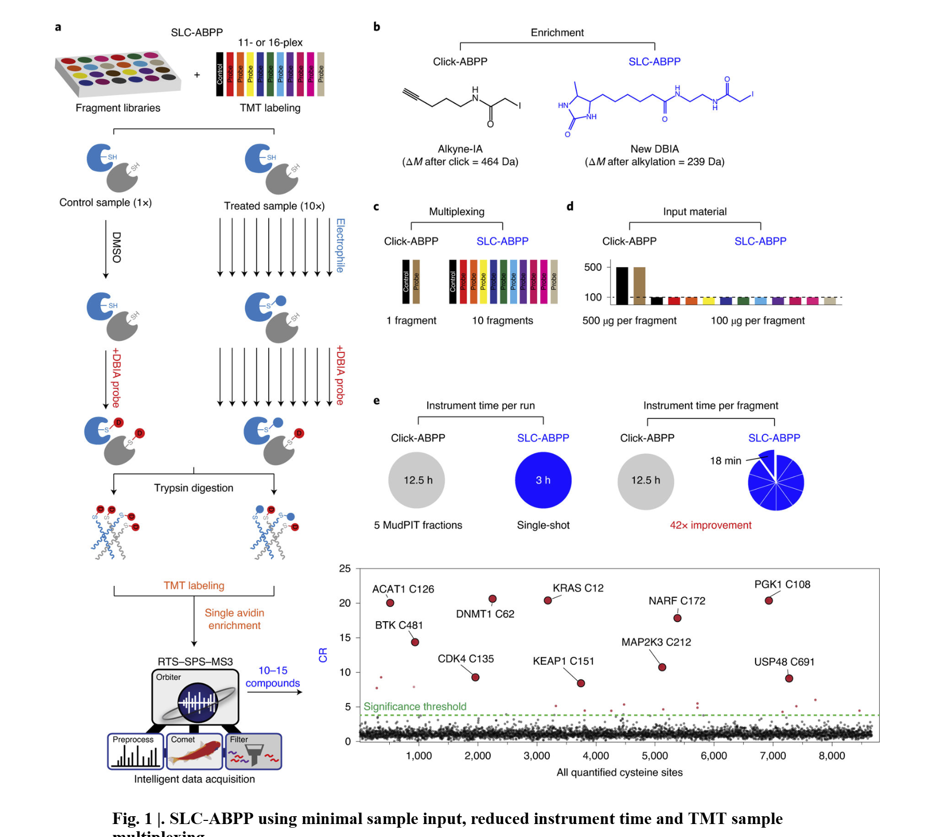
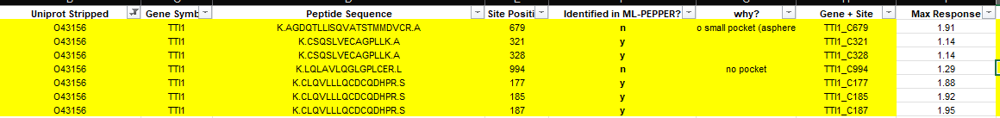
Cross Referencing to Exptl DataSet Is Possible
Gygi lab published a 2021 paper on screening against 3 different cell lysates (HCT119, HEK, PaTU8898) with a collection of acrylamide and chloroacetamide compounds
Authors claimed a 42x improvement over previous methods
Supplemental data provides:
Cys residue identified by MS methods as modified
Degree of modification
Differential across 285 compounds
These can be cross referenced directly from the ML-PEPPER dataset by Uniprot & Site Position/Residue ID
ML-PEPPER identified more Cys (12) than were detected experimentally (7).
26 Cys residues in total in protein.

Slide 28

RDKit for Deep Learning and Chemical Kinetics: Chemprop, RMG, and RDMC

